Slide 1
Practical Project Management & Prof Development
A.V.A Chatbot
By:
Ayodamola Ajibola
Jia Ren Goh
Alex Moreton
Khawla Elmasalati

Slide 2
Presentation outlines
Brief Introduction
Project Aims and Objectives
Existing Alternatives
Development Approach
Results
Limitations and Future Work
Conclusion
Live Demo

Slide 3
Introduction

Slide 4
For my slides I will send alex on facebook a txt file for what to say in each one, and sure u can change if you want...
This what I have used
Font: titles 44 bold Calibri (Body),
Subtitles 28 bold Calibri (Body).
Content 28 Calibri (Body),
Figures 18 Calibri (Body),

Slide 5
Project’s Aims and objective
Way of presenting [just suggesting] so that we all have the same style and slides are consistent
Continues conversation.
Keyword detection.
Profile templates.
Storing user data to database.
Crossing platforms app.

Slide 6
Existing Alternatives
As mentioned by (AISB, 2017) organization Mitsuku chatbot is the winner of the Loebner Prize 2017.
A.V.A inspired by Mitsuku in the following advantages:
Learning from users.
Having :
1.Webpage.
2.Personality.
3.Avatar.

Slide 7
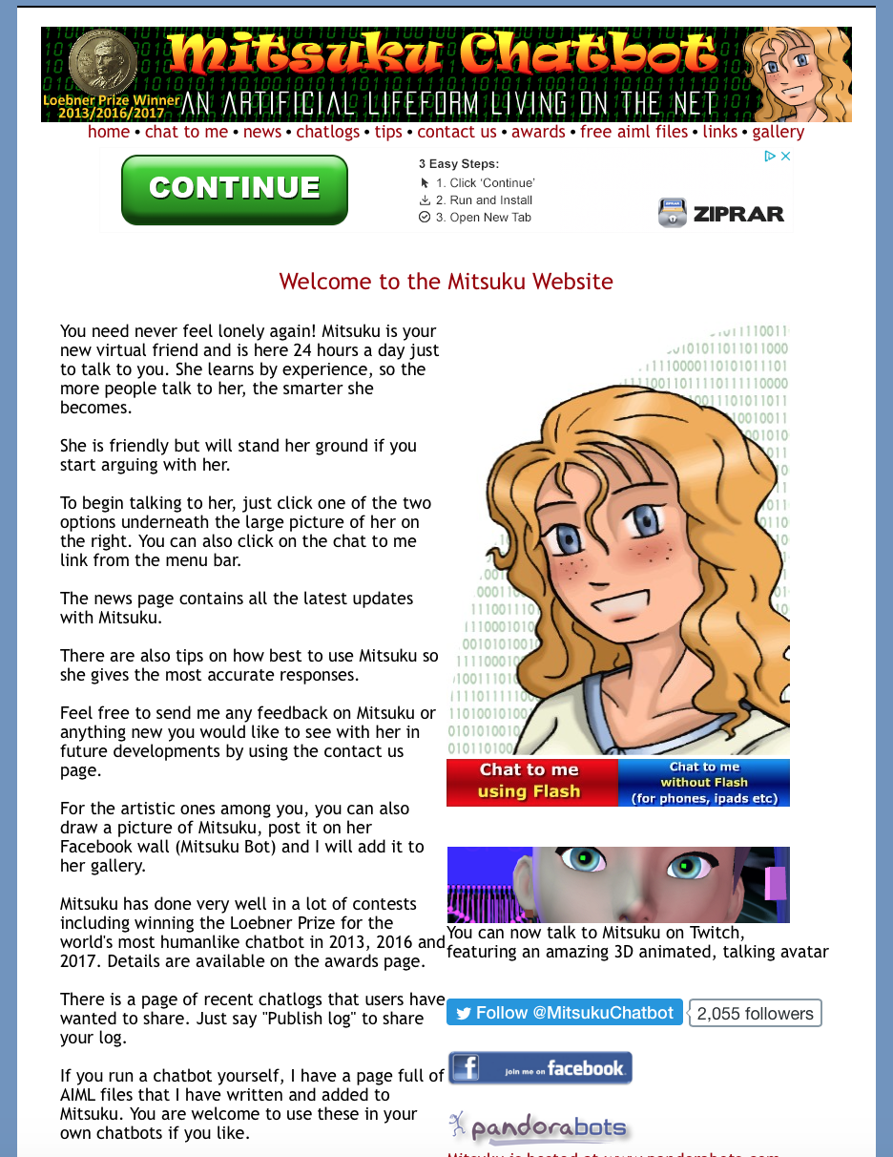
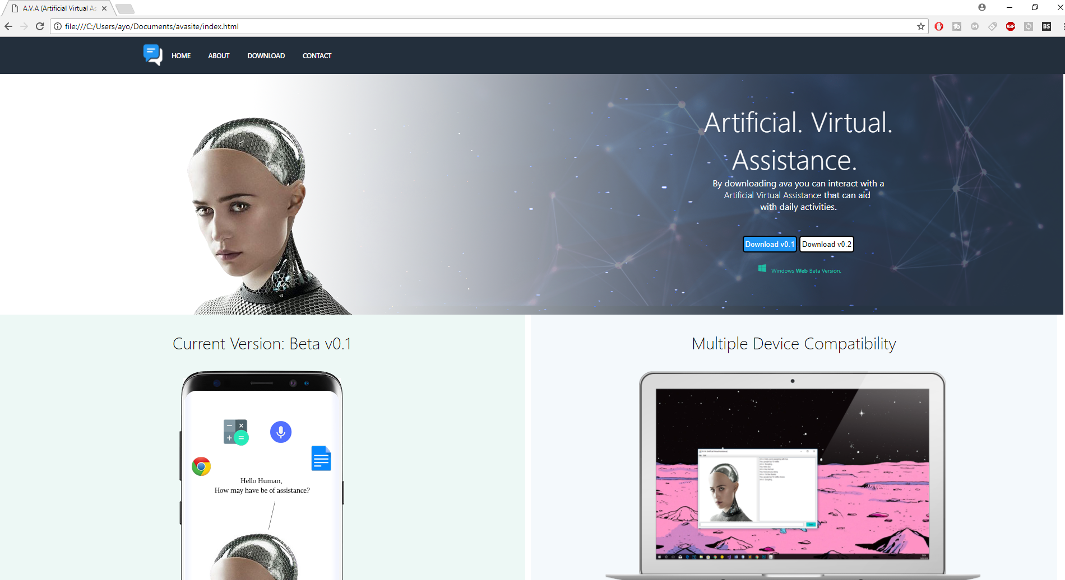
A.V.A improvements comparing to Mitsuku
Website design
Figure1: Mitsuku home webpage.
Figure 2: A.V.A home webpage.

Slide 8
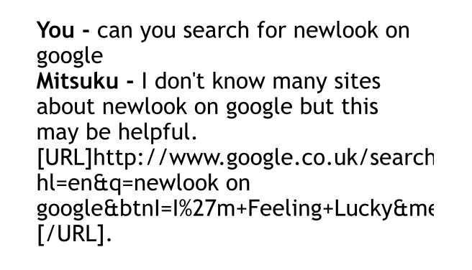
Cont’d
2. Google Searching feature
Img missing the zip file not opening
Figure 3: Mitsuku google search.
Figure 4: A.V.A google search.

Slide 9
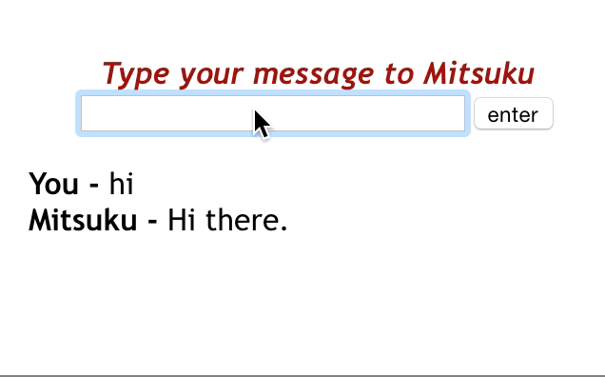
Cont’d
3. “Typing” feature
Video missing here same issue
Figure 5: Mitsuku typing.
Figure 6: A.V.A typing.

Slide 10
development approach
Agile Practice
Flexibility
Easy to Manage
Pivotal Tracker vs. Trello
Pivotal Tracker | Trello
Story-based project management tool | Board-style project management tool
Suited for high-level agile workflow | Suited for low-level projects over a long span of time
Free for up to 3 users for 30-days | Free (Pay for additional storage space)

Slide 11
Results
Completed:
Basic question-answer response
Quick factual searches
Simple interaction with other applications
Text-to-speech
Cross-platform compatibility
Incomplete:
Profile system
Emergency Services/ Support Societies triggers
Customization

Slide 12
limitations and ideas for future work as a minimum
Limitations:
Resources
Priorities
Adaptation
Notes:
Resources – C++ idea had to be scraped. If appropriate amounts of support material was available not only would the language choice of our program be different, but new C++ based programmers can experiment in making their own Chatbot.
Priorities - Due to the fact that the main function of our project was quite challenging numerous minor details (e.g. dealing with resizing of HTML page and UI of the program on other devices such as mobile phones) were not perfected as much as we liked.
Adaptation - While the program itself was a new test for all of us, it was not the only difficulty we faced. Probably the most detrimental one was having to adapt to each other – being able to effectively communicate with one-another and compromising where needed, the product is a reflection of the journey we have been through as a team.

Slide 13
Conclusion
A possible solution, not the ultimate solution
Early stage of development
Opportunity
Caters to all
Notes:
Point 1. A.V.A. seeks to improve on some of the common flaws that similarly existing programs in today’s age have. It should be look at as an idea, not as a business/ corporate
product ready to be launched to the public.
Point 2. Given the simplicity of the main chat capabilities and the light additional functions of the program, it is safe to say that in comparison to other large companies producing chatbot programs that this is a rather solid basis to start evolving from, a version 1 if you could put it otherwise.
Point 3. The code for the program is not overly complex, but rather requires some time and dedication to get working. Any decent student with the right resources could easily
have the opportunity to replicate such a program, opening possibilities for this product to be used in other ways not originally intended (e.g. teaching material for coders)
Point 4. It should not be forgotten that the focus of the product is not just on the program itself, but also on the HTML page and overall management of the team. The final product caters to everyone’s capabilities, and showcases that no weakness should be exploited.

Slide 14
References

Slide 15
Any Questions?

Slide 16
Live Demo

